Slide 1
MultiHop Routing in TinyOS
By Fan & Lai

Slide 2
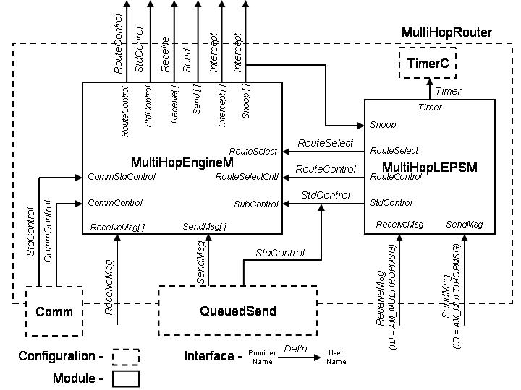
MultiHop Routing Architecture

Slide 3
Component Configuration
MultiHop Router Component
  two main parts
  file : MuliHopRouter.nc
  all components
    MultiHopEngineM
    MultiHopLEPSM
    GenericCommPromiscuous as Comm
    QueuedSend
    TimerC

Slide 4
Packet Movement Logic Component
MultiHopEngineM
  determine the next-hop path
  forward packets out
  file : MultiHopEngineM.nc
  require RouteSelect and RouteControl interfaces

Slide 5
Route Selection Component
Link Estimation & Parent Selection
  Outside Monitoring
    Monitor all the traffic received via the Snoop port
    Receive single-hop route update message (AM_MULTIHOPMSG)
  Internal Management
    Manage the nearest available neighbors
    Decide the next hop destination on shortest path semantics
Mechanism
  Send a route update message every 20 sec.
  re-compute after 50 sec.
  file : MulticHopLEPSM.nc

Slide 6
Routing Data Structure
Routing Table
1 | id | parent
 | missed | received
 | lastSeqno | flags
 | liveliness | hop
 | receiveEst | sendEsts
… | …
16

Slide 7
typedef struct TableEntry {
uint16_t id; (node address)
uint16_t parent; (node’s parent)
uint16_t missed; (比较last和刚收到的seqno得到 )
uint16_t received; (收到一次路由消息自增)
int16_t lastSeqno; (最后收到的路由消息last sequence)
uint8_t flags; (NBRFLAG_VALID, _EST_INIT, _NEW)
uint8_t liveliness; (每次重新计算路由的时候，会被清零；如果平常收到来自该结点发来的路由消息时，自增)
uint8_t hop; (用全局变量来保留的，选完parent后确定)
uint8_t receiveEst; (对链路的评估参数，evaluateCost)
uint8_t sendEst; (对链路的评估参数， evaluateCost)
} TableEntry;

Slide 8
Key Parameters
Name | Parameter Name | Value
Sink Node Address | BASE_STATION_ADDRESS | 0
Route Table Size | ROUTE_TABLE_SIZE | 16
路由评估和路由更新的比例 | ESTIMATE_TO_ROUTE_RATIO | 5
Node是不是需要重设 | ACCEPTABLE_MISSED | -20
数据包和路由更新的比例 | DATA_TO_ROUTE_RATIO | 2
Update Message频率 | DATA_FREQ | 10000
最大link cost | MAX_ALLOWABLE_LINK_COST | 1536
最小生存时间 | MIN_LIVELINESS | 2

Slide 9
Program Flow Chart (Sender)
Timer.fired (for every 20 seconds)
TimerTask ()
updateTable ()
For every table entry (for every 5 Timer fires):
Run updateEst ().
which calculates ‘receiveEst’ using ‘missed’ and ‘received’
chooseParent () by min cost (using ‘receiveEst’ & ‘sendEst’.
Update ‘gpCurrentParent’ & gbCurrentHopCount’
SendRouteTask (): broadcast a routing packet (MultihopMsg).
Routing packet’s payload includes a node’s ID with best 'receiveEst‘.

Slide 10
Program Flow Chart (Receiver)
ReceiveMsg.receive (routing packet)
updateNbrCounters ():
use packet’s ‘addr’ and ‘seqno’
update ‘missed’, ‘received’, ‘lastSeqno’ in the table entry.
Update the ‘parent’, ‘hop’ in the corresponding table entry
Increment ‘liveliness’
and update ‘sendEst’ in the corresponding table entry

